Slide 1
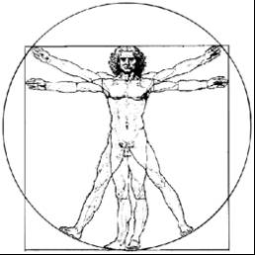
ecbi
2012 Bonn Seminar
The Future of the Kyoto Protocol (Architecture)
Benito Müller,
Oxford Climate Policy
european capacity building initiative
initiative européenne de renforcement des capacités
for sustained capacity building in support of international climate change negotiations
pour un renforcement durable des capacités en appui aux négociations internationales sur les changements climatiques

Slide 2
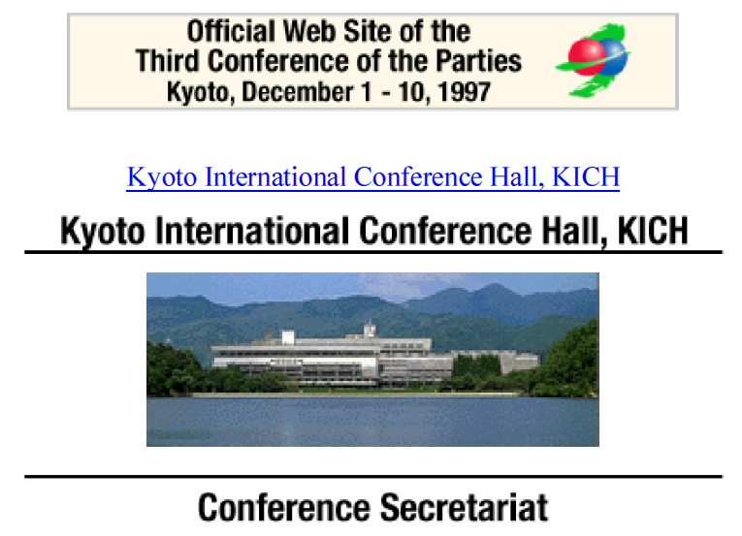
2 years 8 months
28 March - 7 Apr. 1995, Berlin, Germany, COP 1

Slide 3
5 years 6 months

Slide 4
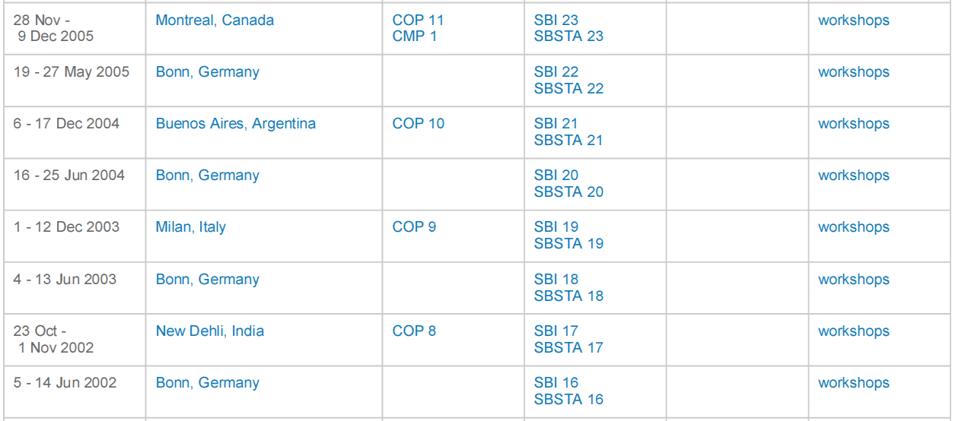
+ 6 years of CMP Decisions!
9 years 6 months

Slide 5
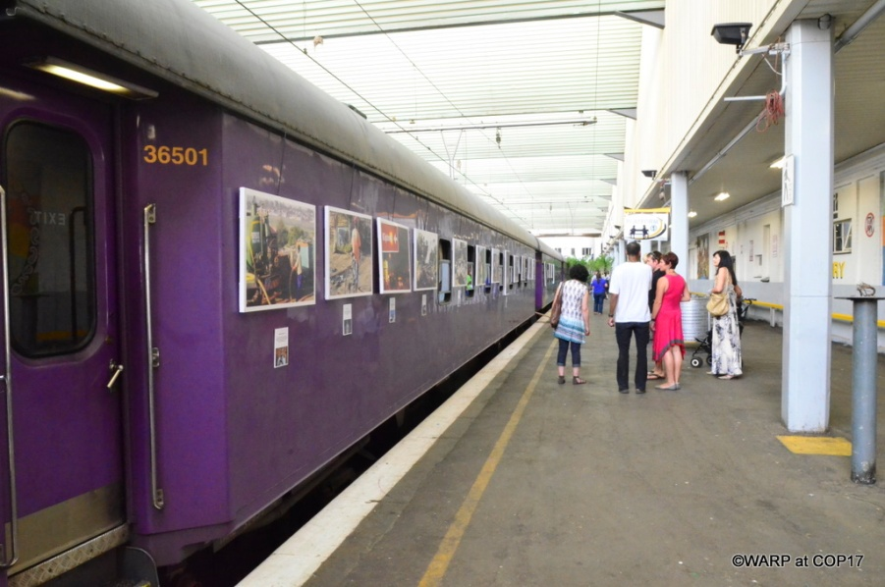
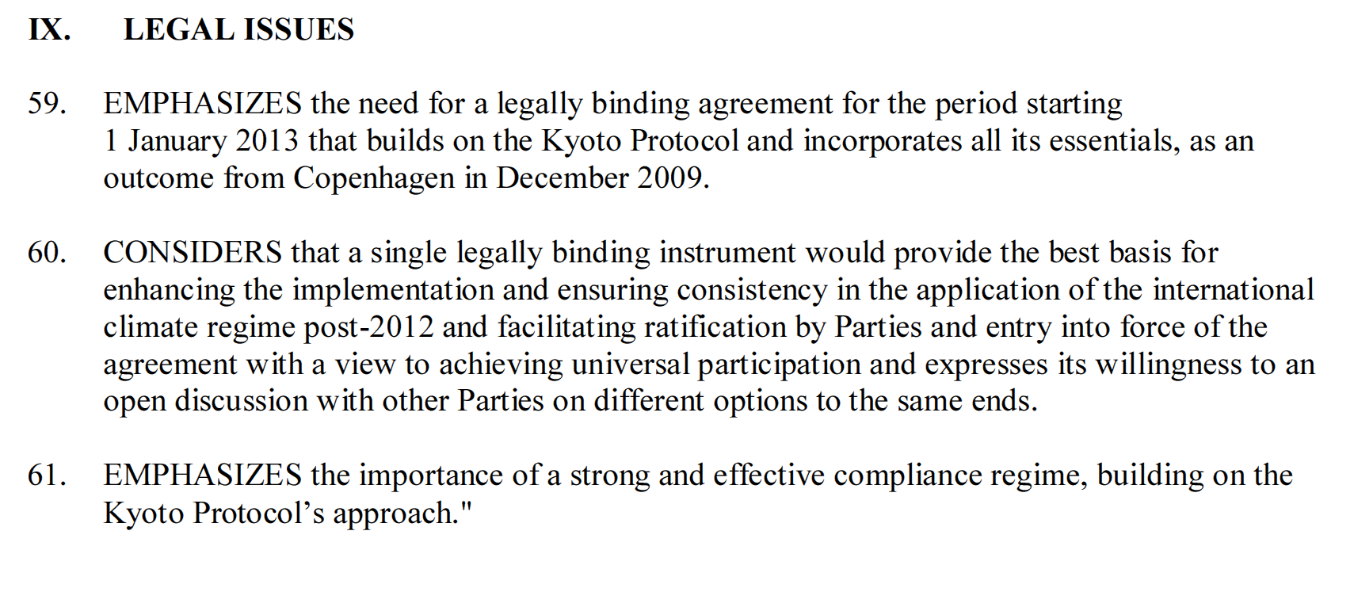
Eurotrack

