Slide 1
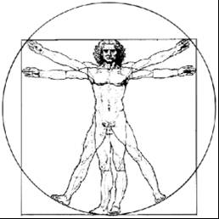
ecbi
‘Common Time Frames’: What & Why?
A CONTRIBUTION TO THE DEBATE ON
ARTICLE 4.10 OF THE PARIS AGREEMENT
Presentation given at the 2018 ecbi Bonn Seminar,
Benito Müller
Director ecbi
european capacity building initiative
initiative européenne de renforcement des capacités
for sustained capacity building in support of international climate change negotiations
pour un renforcement durable des capacités en appui aux négociations internationales sur les changements climatiques

Slide 2
Background
At COP 21 in Paris (2015), it was agreed that the CMA “shall consider common time frames for nationally determined contributions at its first session”[Art. 4.10].
In Marrakech, the year after, the CMA agreed to refer the matter to the SBI which, in 2017 in Bonn, “invited Parties and observers to submit, by 31 March 2018, their views on common time frames for NDCs ... including on, but not limited to, the usefulness of and options for common time frames and the advantages and disadvantages of those options, for consideration at SBI 48 (April–May 2018)”[SBI 47 conclusions].

Slide 4
What Common Time Frames?
1. Material Interpretations: Periods of Implementation or Target Periods
(Potential) Period of Implementation (POI) and Target Period (TP)
POI begins with the communication of the NDC
POI ends with the end of the NDC TO
TP.1
TP.2
TP.3
TP.4
POI.1
POI.2
POI.3
POI.4
TP.1
TP.2
TP.3
TP.4
IP.1
IP.2
IP.3
IP.4
TP.1
POI.1
TP.1
POI.2
Notes:
POI: Begins with the announcement of the Target Period and ends with the end of the TP

Slide 5
What Common Time Frames?
1. Material Interpretations: Periods of Implementation or Target Periods
Potential landing ground: communication in 2025 of NDC beginning in 2031
2035 NDC TP
2035 NDC POI
2040 NDC TP
2040 NDC POI
2045 NDC TP
2045 NDC POI
2025
2030
2035

Slide 6
What Common Time Frames?
1. Material Interpretations: Periods of Implementation or Target Periods
Potential landing ground: communication in 2025 of NDC beginning in 2031
2040 NDC TP
2040 NDC POI
2045 NDC TP
2045 NDC POI
2050 NDC TP
2050 NDC POI
2025
2030
2035

Slide 7
What Common Time Frames?
2. Procedural Interpretation: Communication/Updating Timetable
§ 23. Urges those Parties whose INDC … contains a time frame up to 2025 to communicate by 2020 a new nationally determined contribution and to do so every five years thereafter …;
§ 24. Requests those Parties whose INDC … contains a time frame up to 2030 to communicate or update by 2020 these contributions and to do so every five years thereafter …;

Slide 8
Dynamic Contribution Cycle
2035
D. Government assessment of indicated
longer-term ambition vision
2030
2035
Updated & Fixed 2030 Ambition
B. Indicating longer-term
ambition
vision
2025
Indicated 2030 Ambition
Updated & Fixed 2025Ambition (NDC)
2020
Indicated 2025 Ambition (INDC)
A. Ratcheting-up and
locking-in short-term ambition
C. Public assessment of indicated
longer-term ambition vision
2020
2025
2030
2023
2028
Global Stocktake
Global Stocktake

Slide 9
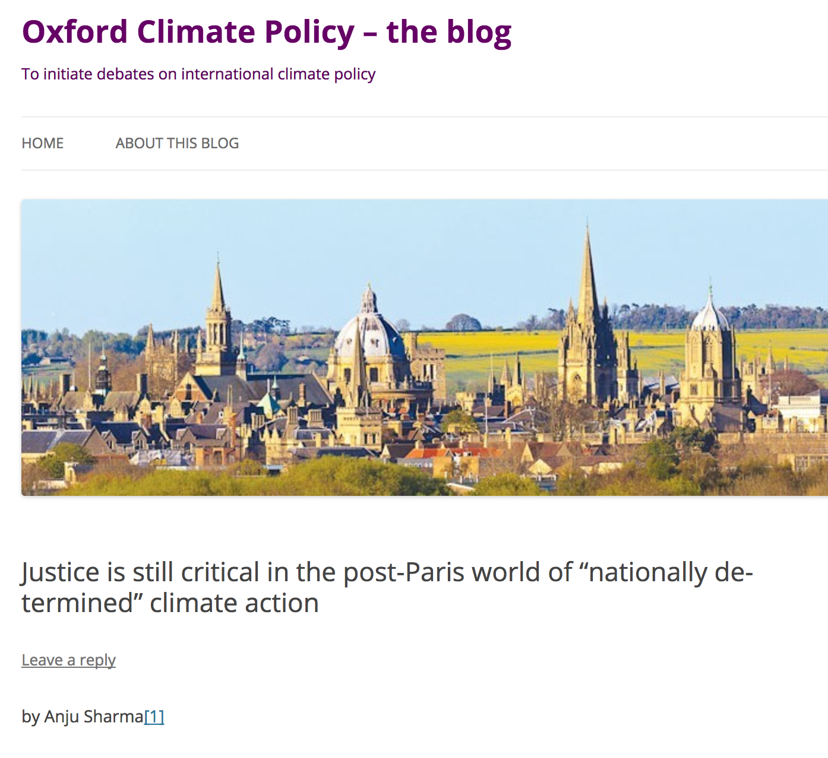
Why?

Slide 10
What’s Justice got to do with it?
Government assessment of indicated
longer-term ambition vision
Indicating longer-term
ambition
vision
Indicated 2030 Ambition
Public assessment of indicated
longer-term ambition vision
Global Stocktake

Slide 11
The Dynamic Ambition Mechanism
HOW?
Urges those Parties whose INDC … contains a time frame up to 2025 to communicate by 2020 a new nationally determined contribution and to do so every five years thereafter …;[§ 23]
Requests those Parties whose INDC … contains a time frame up to 2030 to communicate or update by 2020 these contributions and to do so every five years thereafter …;[§ 24]
Request all Parties in 2025 to update their 2030 NDC, and communicate an indicative 2035 NDC, and to do so every five years thereafter.

Slide 12
Party Submissions
Trinidad & Tobago and Belize
"In order to synchronize the NDCs of Parties that have differing timeframes, and consistent with the intention of paragraphs 23 and 24 of Decision 1/CP.21, it is proposed that all Parties utilize a 5+5-year dynamic NDC cycle commencing in 2025, at which time all Parties would update and submit their 2030 NDC and communicate an indicative 2035 NDC. In 2030 all Parties would then update and submit this previously indicative 2035 NDC and communicate an indicative 2040 NDC. And so forth. This dynamic NDC cycle would not only facilitate maximum enhancement of short-term (five-year) ambition, but also provide a ten-year ambition indication as medium-term planning horizon.
Given paragraphs 23 and 24 of Decision 1/CP.21, this dynamic NDC cycle could be brought about by simply requesting all Parties in 2025 to update their 2030 NDC and communicate an indicative 2035 NDC, and to do so every five years thereafter."[emphasis added]
The Group of Least Developed Countries
"Dynamic 5+5 contribution cycles. The LDC Group proposes a dynamic NDC cycle of 5+5 years in which Parties communicate a 5-year NDC for an upcoming 5-year implementation period and simultaneously provide a subsequent indicative NDC for the following 5-year implementation period. At the next NDC communication cycle, a Party would communicate or update their previously indicative 5-year NDC for the upcoming implementation period as well as provide a new indicative 5-year NDC for the following 5-year implementation period.
In this way, Parties would be able to maximise short-term ambition by avoiding locking in low ambition for long periods while giving Parties an opportunity to effectively plan medium- and long-term climate efforts and provide needed certainty and direction of travel to key stakeholders in the public, private and civil society sectors.”

Slide 13
Merci!

Slide 14
Oxford Climate Policy
21-30
21-30
21-25
26-30
Requests those Parties whose INDC … contains a time frame up to 2025 to communicate by 2020 a new nationally determined contribution and to do so every five years thereafter …;[§ 23]
Requests those Parties whose INDC … contains a time frame up to 2030 to communicate or update by 2020 these contributions and to do so every five years thereafter …;[§ 24]
Requests all Parties in 2025 to update their 2030 NDC,
and communicate an indicative 2035 NDC, and to do so every five years thereafter.
2020
21-25
21-30
31-35
21-30
26-30
26-30
31-35
2025
31-35
2030
31-35
36-40
36-40
36-40
2035
= fixed
= indicated
= updated & fixed

Slide 15
Brazil
21-30
21-30
21-25
26-30
2020
21-25
21-30
31-35
26-30
31-35
2025
2030
31-35
36-40
36-40
2035
21-30
21-30
21-30
21-30
31-35
26-30
21-25
26-30
21-25
21-25
2020
21-25
2020
31-35
21-30
31-35
36-40
21-30
31-35
31-35
21-30
26-30
26-30
36-40
26-30
31-35
31-35
31-35
2025
2025
31-35
31-35
36-40
2030
31-35
36-40
2030
36-40
41-45
36-40
41-45
36-40
41-45
36-40
2035
2035

Slide 16
What Common Time Frames?
1. Material Interpretations: Periods of Implementation & Target Periods
Example of a 2025 NDC:
Average annual emissions between 2015 and 2025 to be reduced to X by 2025,
with implementation to start in 2021
2025 NDC Target Period
2025 NDC PoI
2015
2020
2025
NB: Target periods could overlap!
2025 NDC: Average annual emissions between 2015 and 2025 to be reduced to X by 2025;
2030 NDC: Average annual emissions between 2020 and 2030to be reduced to Y by 2030.
2025 NDC target period
2030 NDC target period
2015
2020
2025
2030

Slide 17
Submissions
Brazil
21-30
21-30
Reaffirm that, pursuant to decision 1/CP.21, paragraphs 23 and 24,
Parties who have communicated an intended NDC with a 2025 target should communicate by 2020 a new NDC with a 2030 target, and
Parties who have communicated an intended NDC with a 2030 target should communicate a new or updated NDC with a 2030 year target; and
agree that future successive NDCs will have common time frames of five years between the end points of two successive NDCs, to be communicated every 5 years starting in 2025.
21-25
26-30
2020
21-25
21-30
31-35
26-30
31-35
2025
2030
31-35
36-40
36-40
2035
= fixed

Slide 18
DCC with time-lag
Requests those Parties whose INDC … contains a time frame up to 2025 to communicate by 2020 a new nationally determined contribution and to do so every five years thereafter …;[§ 23]
Requests those Parties whose INDC … contains a time frame up to 2030 to communicate or update by 2020 these contributions and to do so every five years thereafter …;[§ 24]
Requests all Parties in 2020 to communicate an indicative 2035 NDC;
Requests all Parties in 2025 to update their 2035 NDC,
and communicate an indicative 2040 NDC, and to do so every five years thereafter.
21-30
21-30
31-35
21-25
26-30
2020
21-25
31-35
21-30
31-35
36-40
31-35
26-30
31-35
36-40
31-35
2025
31-35
36-40
2030
36-40
41-45
36-40
41-45
41-45
2035
= fixed
= indicated
= updated

Slide 19
Archive Slides

Slide 20
What Common Time Frames?
1. Material Interpretations: Periods of Implementation or Target Periods
TP.1
TP.2
TP.3
TP.4
IP.1
IP.1
IP.1
IP.1
TP.1
TP.2
IP.1
IP.2
TP.1
TP.2
TP.3
TP.4
IP.1
IP.2
IP.3
IP.4
TP.1
TP.2
IP.1
IP.2

Slide 21
§24 Track with mid-term updates
(b) §24 track
21-30
INDC 21-30
2020
21-30
2025 Lock-in of systematically enhanced short-term ambition
2025
31-40
2030 Cliff-hanger
2030
31-40
2035 Lock-in of systematically enhanced short-term ambition
2035
41-50
2040 Cliff-hanger
2040
Plus:
Some systematic enhancement of medium-term (10 year) ambition
Some medium-term vision/planning horizons
Minus:
Decadal cliff hangers
NB: All Parties need to engage in a domestic debate every five years, at least if updating is meant to be taken seriously.

Slide 22
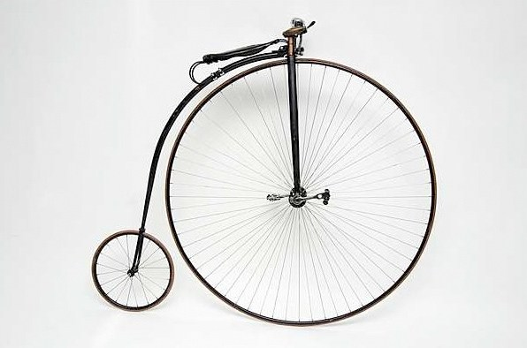
The Two-track Communication Cycle
§ 23. Urges those Parties whose INDC … contains a time frame up to 2025 to communicate by 2020 a new nationally determined contribution and to do so every five years thereafter …;
§ 24. Requests those Parties whose INDC … contains a time frame up to 2030 to communicate or update by 2020 these contributions and to do so every five years thereafter …;
§ 23-track
§ 24-track

Slide 23
§24 Track with end-term updates
NB: All Parties need to engage in domestic debate every five years, at least if updating is meant to be taken seriously.
INDC 21-30
Locking-in of systematically enhanced 10-year ambition
2020
21-30
Risk of locking-in unenhanced 15-year low ambition
2025
31-40
Locking-in of systematically enhanced 10-year ambition
2030
31-40
Risk of locking-in unenhanced 15-year low ambition
Plus:
Some systematic enhancement of medium-term (10 year) ambition
Medium to longer-term vision/planning horizon
Minus:
Risk of locking-in unenhanced longer-term (15-year) low ambition
2035
§ 24. Requests those Parties whose INDC … contains a time frame up to 2030 to communicate or update by 2020 these contributions and to do so every five years thereafter …;
nn-yy
= Updating of 20yy-NDC
nn-yy
= Communication of 20yy-NDC

Slide 24
§23 ‘1 + 1 Step’ Track & §24 Track with end-term updates
(a) §23 track
(b) §24 track
2020
21-25
26-30
2020
21-30
2025
26-30
31-35
2025
31-40
2030
31-35
36-40
2030
31-40
2035
36-40
2035
‘RCP’ = Review & Communication Period
2025 RCP
2030 RCP
2035 RCP
16
17
18
19
20
22
23
24
25
26
27
28
29
30
31
32
33
34
35
No coherence between § 23 and § 24 tracks whatsoever
§23: Communication of
2025 & 2030 NDC
§23: Communication of 2035 NDC
§23: Communication of 2040 NDC
§23: Communication of 2045 NDC
§24: Updating of 2030 NDC
§24: Communication of 2040 NDC
§24: Updating of 2040 NDC
§24: Communication of 2050 NDC

Slide 25
§23 ‘1 + 1 Step’ Track & §24 Track with mid-term updates
(a) §23 track
(b) §24 track
21-25
26-30
2020
21-25
2020
21-30
2025
26-30
31-35
2025
21-30
2030
31-35
36-40
2030
31-40
2035
36-40
2035
31-40
‘RCP’ = Review & Communication Period
2025 RCP
2030 RCP
2035 RCP
16
17
18
19
20
22
23
24
25
26
27
28
29
30
31
32
33
34
35
§23: Communication of 2025 NDC
§23: Communication of 2035 NDC
§23: Communication of 2045 NDC
Communication of 2030 NDC
§24: Updating of 2030 NDC
Communication of 2030 NDC
Communication of 2040 NDC
§24: Updating of 2040 NDC
Communication of 2040 NDC
= §23/§24 parallel national activities
= harmonized national activities

Slide 26
The Review Cycle
Facilitative Dialogue
National Determination and Submission of NDCs
Clarification of Submissions
Synthesis Report of NDCs
Global Stocktake
National Determination and Submission of NDCs and National Review of NDCs
Clarification of Submissions
Synthesis Report of NDCs
Global Stocktake
National Determination and Submission of NDCs and National Review of NDCs
Clarification of Submissions
Synthesis Report of NDCs
Global Stocktake
National Determination and Submission of NDCs and National Review of NDCs
Clarification of Submissions
Art 14.2. The CMA shall undertake its first global stocktake in 2023 and every five years thereafter.
The outcome of the Stocktake is meant to inform Parties in updating and enhancing their actions and support.
§25: Parties are to submit (≠ communicate) their NDCs “at least 9 to 12 months in advance of the relevant session of the CMA
with a view to facilitating the clarity, transparency and understanding of these contributions,
including through a synthesis report prepared by the secretariat”.
2025 RCP
2030 RCP
2035 RCP
16
17
18
19
20
21
22
23
24
25
26
27
28
29
30
31
32
33
34
35
‘RCP’ = Review & Communication Period

Slide 27
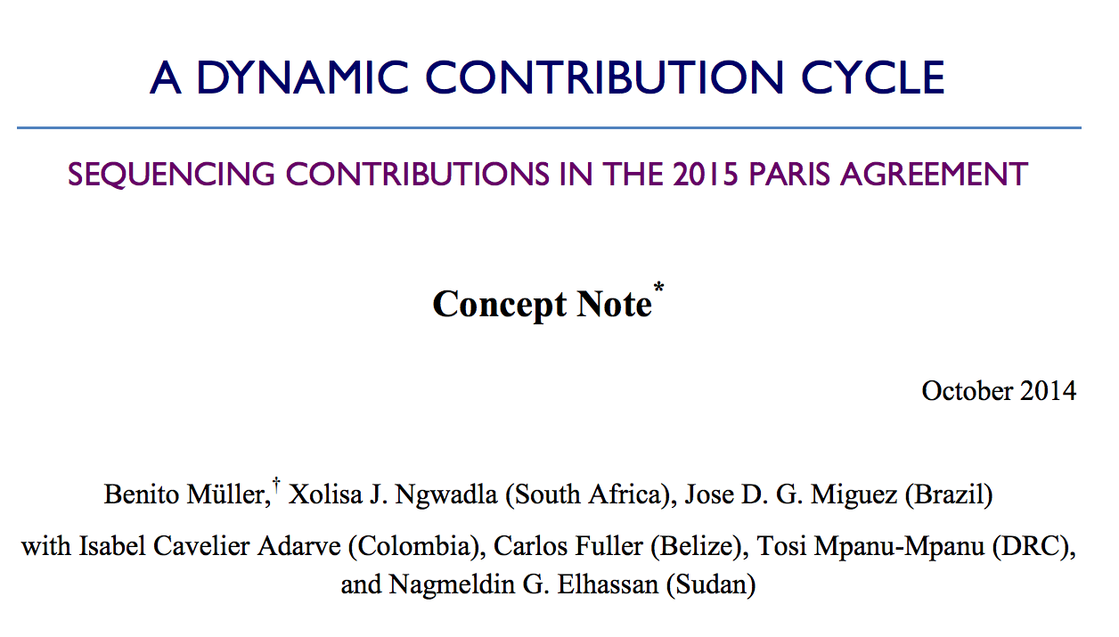

Slide 28
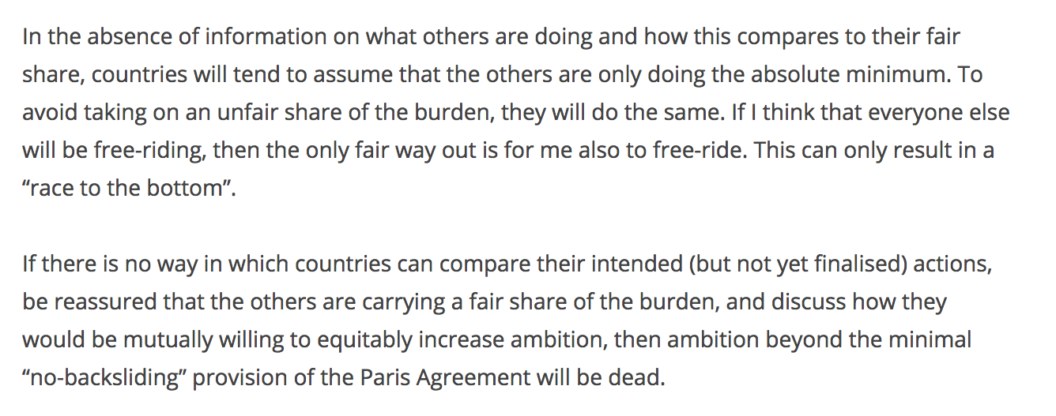
Why?

Slide 29
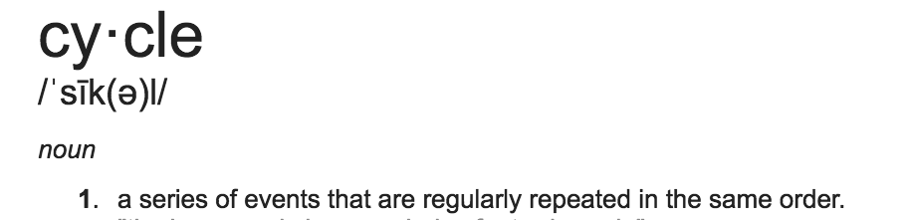
Definitions

Slide 30
Definitions
Recurring
Event 2
Example: Two different cycles with different periodicities and starting points
Recurring
Event 0
(Start/End)
Recurring
Event 1
Period n
Period n+1
Period m
Period m+1
Period m+2
Period m+3
Review Cycle and Communication Cycle both have five-year periodicity and the same end ‘points’: 31 December 2025, 30, 35…
The Cycles share common five-year “Review and Commumication Periods”
2025 RCP
2030 RCP
2035 RCP
21
22
23
24
25
26
27
28
29
30
31
32
33
34
35

